Slide 1

Arduino Workshop
Hosted by: Gustavo Correa and Gian Ocampo
Location: Creat’R Lab @ UCR
Today’s Date: May 9th, 2017
Schedule: Weekly, 4/25/17 - 5/30/17
Slideshow link: http://bit.ly/ArduinoWorkshopSlides
Creat’R Lab Calendar: http://guides.lib.ucr.edu/c.php?g=645451&p=4523510

Slide 2
Overview
Workshop Update
Cutie Hacks and other Creat’R Lab Workshops
Serial Communication
Installing Libraries
Peripheral Demos!
Ultrasonic
Servo Motor
Buzzer
Mechanical Switch
Humidity Sensor

Slide 3
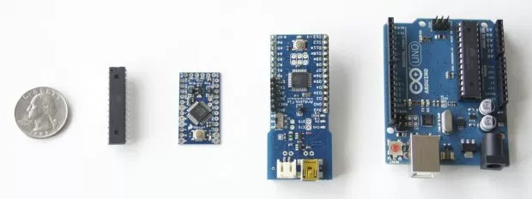
Workshop Update
Our next workshop is on May 16th!
We will have another Arduino Lecture/Activity
Register for Cutie Hack!
On Saturday May 20th from 8AM-10PM
Please fill out the Feedback Form!
https://goo.gl/forms/linh2N6otbGF7Pu53
Attend other Creat’R Lab Workshops!
http://guides.lib.ucr.edu/c.php?g=645451&p=4523510

Slide 4
Apply here! - https://cutiehack.com/#/main

Slide 5

Feedback Form! - https://goo.gl/forms/y0yOIfM2FEGZnOBC3

Slide 6






Creat’R Lab Schedule ! - http://guides.lib.ucr.edu/c.php?g=645451&p=4523510

Slide 7
Serial Communication

Slide 8
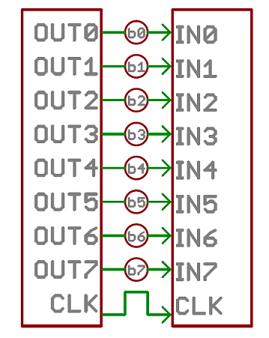
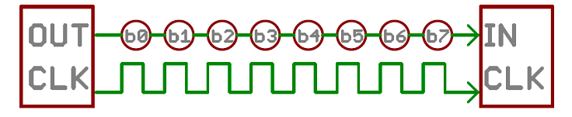
What is Serial Communication?
Parallel vs Serial(diagram)
Sending data bit by bit at a fast rate
Serial Monitor
Uses:
Sending data between two Arduinos
Components such as the Touch Screen Display

Slide 9
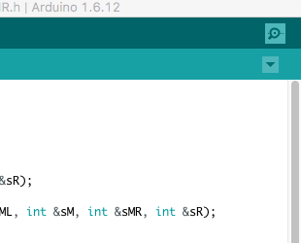
The Serial Monitor
Allows you to get feedback from the Arduino
Good for getting outputting data, debugging and text games????

Slide 10
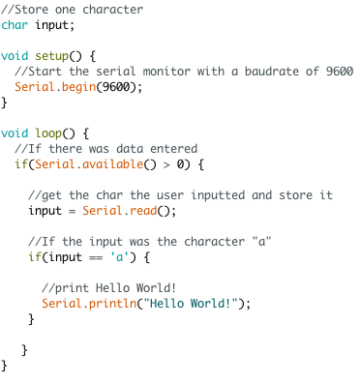
The code!
Built-in
No wiring needed(just hook up Arduino)

Slide 11
Installing Libraries
Tutorial Link: https://www.arduino.cc/en/guide/libraries
*All Installing Library material was provided by Arduino*

Slide 12

What are Libraries?
Arduino Libraries are NOT physical libraries with books :D
Libraries are a collection of code that makes it easy for you to connect to a sensor, display, module, etc.
There are hundreds of additional libraries available on the Internet for download.

Slide 13
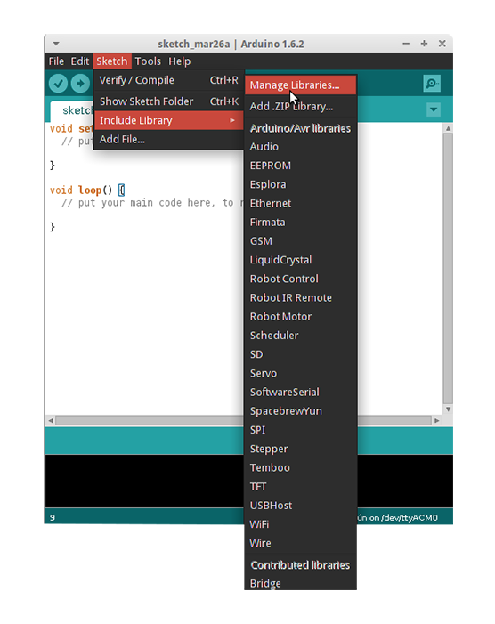
Option 1: Using the
Library Manager
To install a new library into your Arduino IDE you can use the Library Manager (available from IDE version 1.6.2).
Open the IDE and click to the "Sketch" menu and then
Include Library > Manage Libraries.

Slide 14
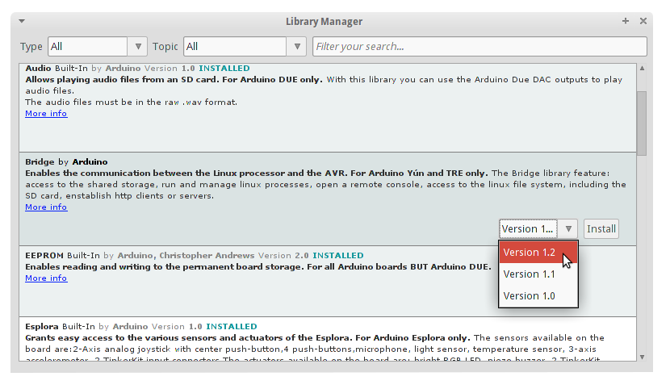
Option 1: Using the
Library Manager
Scroll the list to find it, then select the version of the library you want to install.
Finally click on install and wait for the IDE to install the new library.
Once done an Installed tag should appear next to the Bridge library. You can close the library manager.

Slide 15
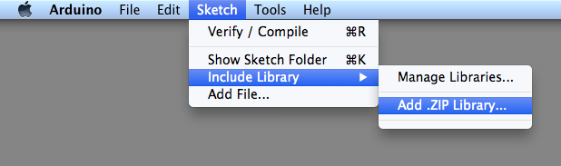
Option 2: Importing a .zip Library
Libraries are often distributed as a ZIP file or folder.
Navigate to Sketch > Include Library.
At the top of the drop down list, select the option to "Add .ZIP Library''.

Slide 16
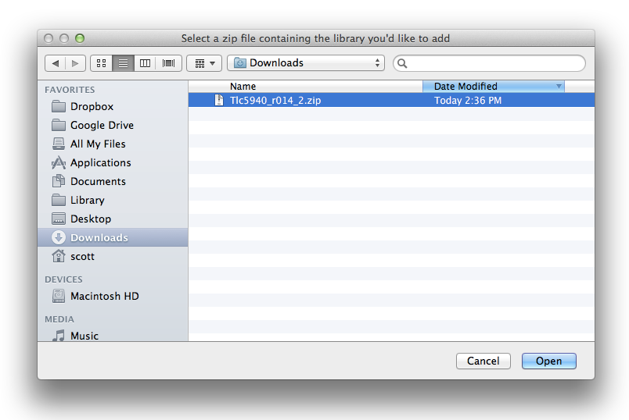
Option 2: Importing a .zip Library
You will be prompted to select the library you would like to add.
Navigate to the .zip file's location and open it.

Slide 17
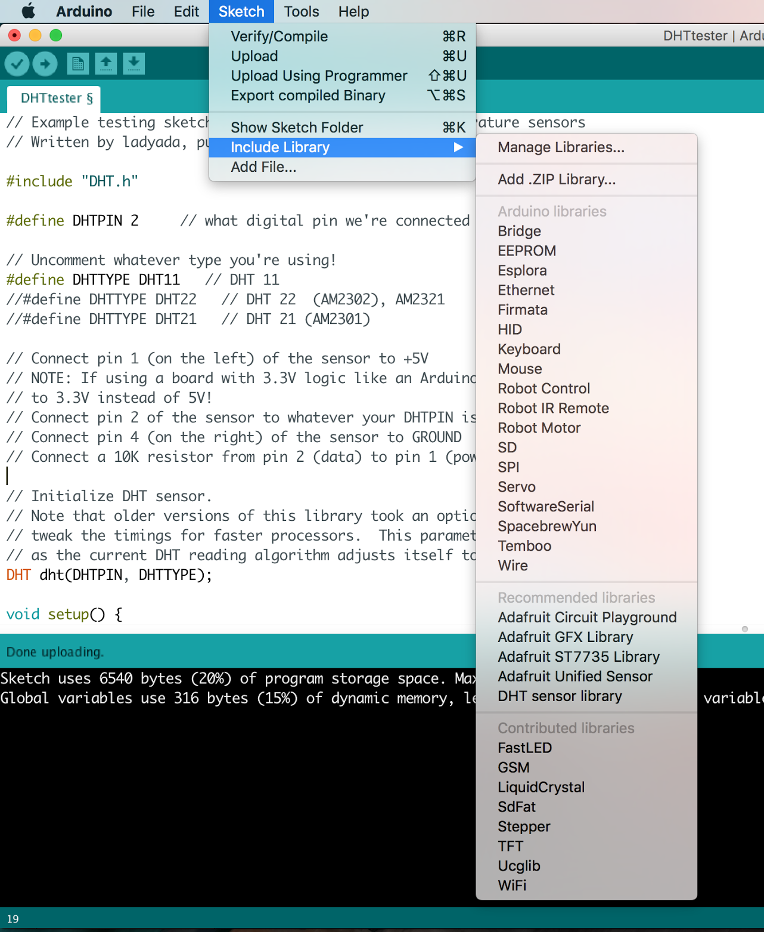
Option 2: Importing a .zip Library
Return to the Sketch > Import Library menu.
You should now see the library at the bottom of the drop-down menu.
It is ready to be used in your sketch.
The zip file will have been expanded in the libraries folder in your Arduino sketches directory.

Slide 18
Option 3: Manual Installation
When you want to add a library manually, you need to download it as a ZIP file, expand it and put in the proper directory.
The ZIP file contains all you need, including usage examples if the author has provided them.
The library manager is designed to install this ZIP file automatically as explained in the former chapter, but there are cases where you may want to perform the installation process manually and put the library in the libraries folder of your sketchbook by yourself.

Slide 19
Option 3: Manual Installation
Arduino libraries are managed in three different places: inside the IDE installation folder, inside the core folder and in the libraries folder inside your sketchbook.
The location of your sketchbook defaults to “..\<you>\DOCUMENTS\Arduino” on Windows machines.
The path is clearly shown in the Preferences panel. If you want to see where the sketchbook defaults open Preferences under File.

Slide 20
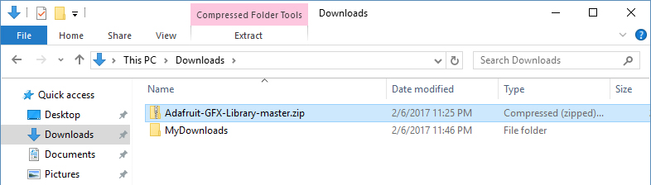
Option 3: Manual Installation
Go to the directory where you have downloaded the ZIP file of the library

Slide 21
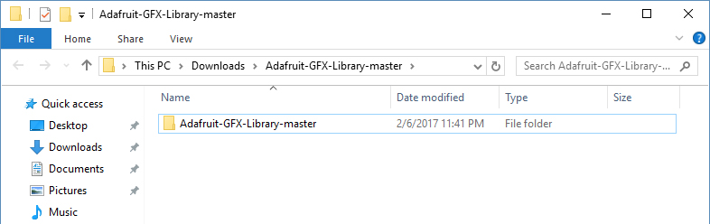
Option 3: Manual Installation
Extract the ZIP file with all its folder structure in a temporary folder, then select the main folder, that should have the library name

Slide 22
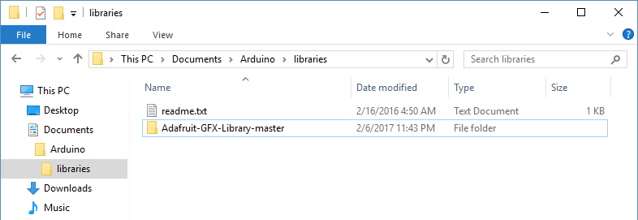
Option 3: Manual Installation
Copy it in the “libraries” folder inside your sketchbook.

Slide 23
Option 3: Manual Installation
Extract the ZIP file with all its folder structure in a temporary folder, then select the main folder, that should have the library name

Slide 24
Option 3: Manual Installation
Go to the directory where you have downloaded the ZIP file of the library

Slide 25
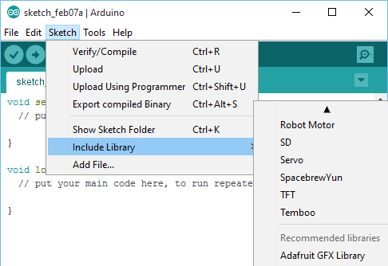
Option 3: Manual Installation
Start the Arduino Software (IDE), goto Sketch and the Include Library.
Verify that the library you just added is available in the list, after the core libs.

Slide 26
Servo Motor

Slide 27

Specs
Part: Tower Pro Micro Servo(SG90)
Any Servo that takes in a 5V input will work though

Slide 28
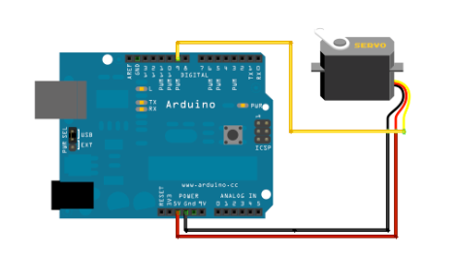
Wiring
Orange Wire on this Servo goes to digital pin(Pin 9 in this case)
Red Wire is to 5V
Brown Wire is to GND

Slide 29
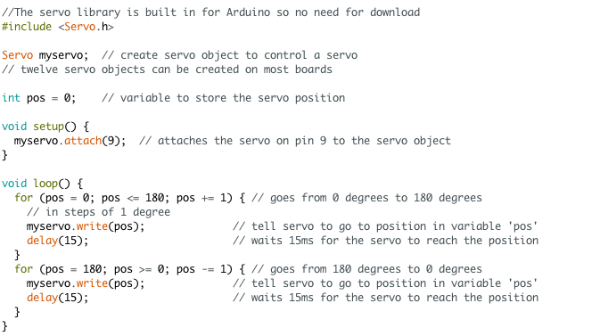
The code
Arduino has a built in Servo library
No download needed
Sweep Sketch
Knob Sketch

Slide 30
Piezo Buzzer

Slide 31
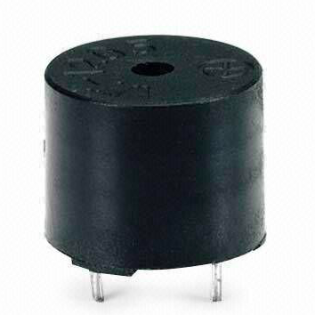
Sensor Specs
Part: WT-1205 Buzzer
Description:
https://www.digikey.com/product-detail/en/soberton-inc/WT-1205/433-1028-ND/479674
Tutorial Links:
https://learn.adafruit.com/adafruit-arduino-lesson-10-making-sounds/playing-a-scale

Slide 32
Ultrasonic Sensor

Slide 33
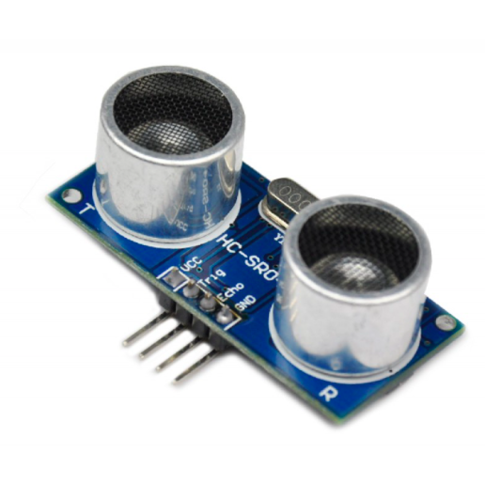
Sensor Specs
Part: HC-SR04
Description:
http://www.micropik.com/PDF/HCSR04.pdf
Tutorial Links:
http://howtomechatronics.com/tutorials/arduino/ultrasonic-sensor-hc-sr04/

Slide 34
Mechanical Switch

Slide 35
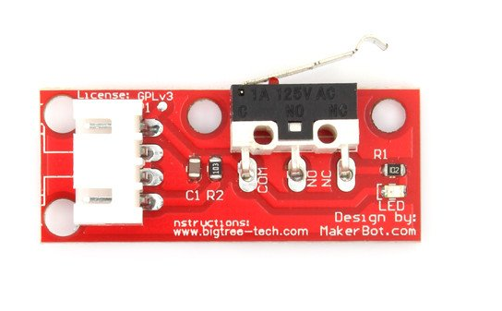
Sensor Specs
Part: Mechanical Endstop
Description and Tutorial: http://reprap.org/wiki/Mechanical_Endsto

Slide 36
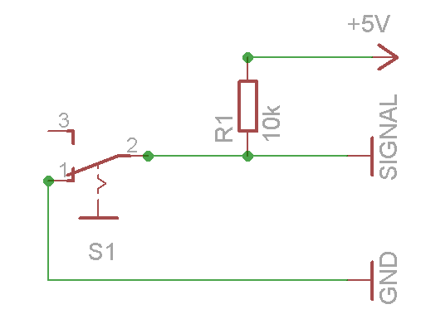
Wiring
Connect Signal(Green Wire) to a digital pin on the Arduino

Slide 37
Temperature/Humidity Sensor

Slide 38
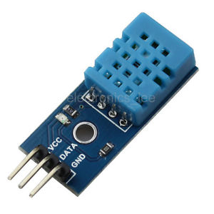
Sensor Specs
Part: DHT11 basic temperature-humidity sensor
Description: https://www.adafruit.com/product/386
Tutorial Links: https://learn.adafruit.com/dht

Slide 39
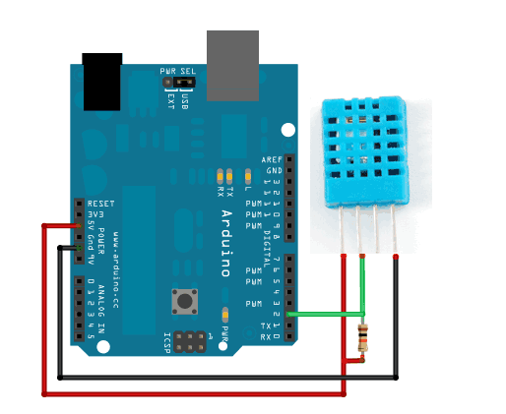
Wiring

Slide 40
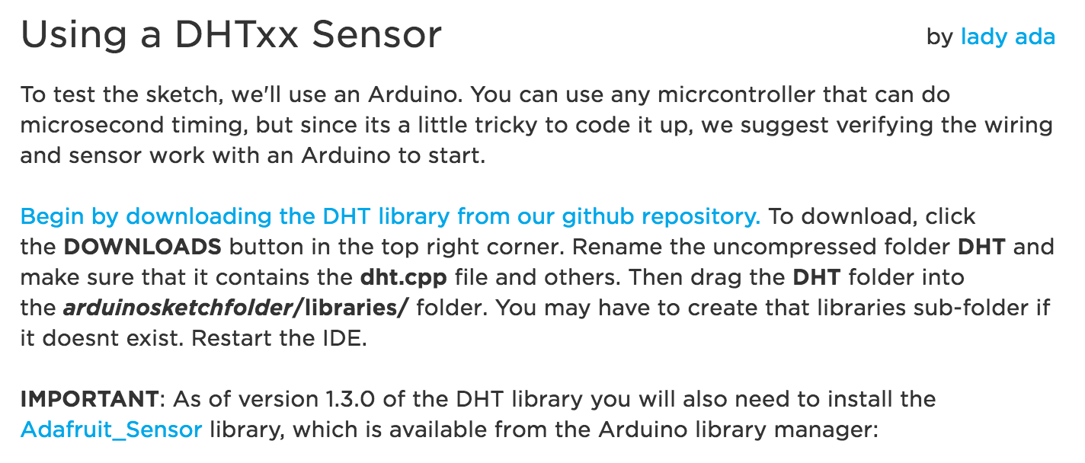
How to use it?
Continue tutorial on https://learn.adafruit.com/dht/using-a-dhtxx-sensor

Slide 41
Done!!!
Next workshop date:
Tuesday May 16th
Thanks for coming!!!

Slide 42
Sources
Arduino Library Tutorial
https://www.arduino.cc/en/guide/libraries
Used for instructional material

